Slide 1
Basics of C and control structures

Slide 2
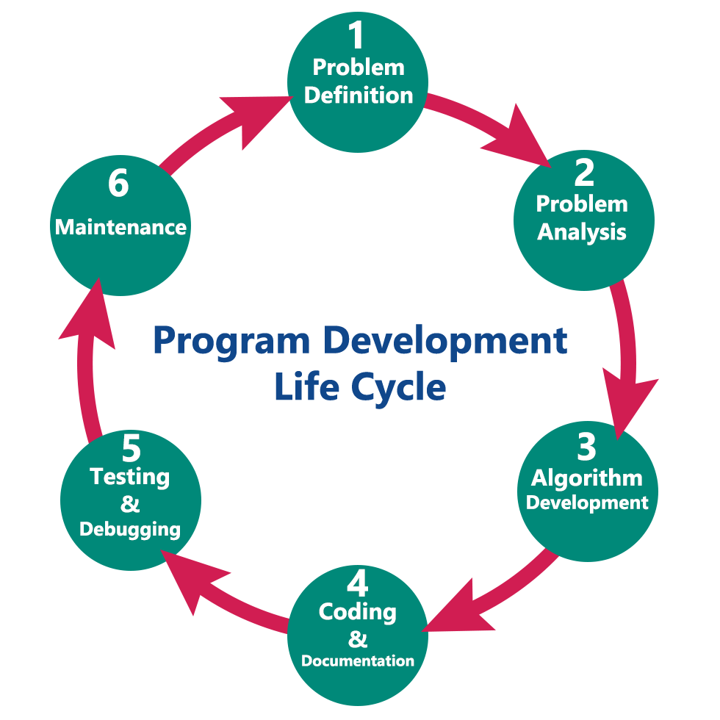
Program development in C
The program development life cycle is a set of steps or phases that are used to develop a program in any programming language.
Generally, the program development life cycle contains 6 phases, they are as follows….
Problem Definition
Problem Analysis
Algorithm Development
Coding & Documentation
Testing & Debugging
Maintenance

Slide 3
Problem Definition and Problem Analysis
1. Problem Definition
In this phase, we define the problem statement and we decide the boundaries of the problem. In this phase we need to understand the problem statement, what is our requirement, what should be the output of the problem solution. These are defined in this first phase of the program development life cycle.
2. Problem Analysis
In phase 2, we determine the requirements like variables, functions, etc. to solve the problem. That means we gather the required resources to solve the problem defined in the problem definition phase. We also determine the bounds of the solution.

Slide 4
Algorithm Development and Coding & Documentation
3. Algorithm Development
During this phase, we develop a step by step procedure to solve the problem using the specification given in the previous phase. This phase is very important for program development. That means we write the solution in step by step statements.
4. Coding & Documentation
This phase uses a programming language to write or implement the actual programming instructions for the steps defined in the previous phase. In this phase, we construct the actual program. That means we write the program to solve the given problem using programming languages like C, C++, Java, etc.,

Slide 5
Testing & Debugging and Maintenance
5. Testing & Debugging
During this phase, we check whether the code written in the previous step is solving the specified problem or not. That means we test the program whether it is solving the problem for various input data values or not. We also test whether it is providing the desired output or not.
6. Maintenance
During this phase, the program is actively used by the users. If any enhancements found in this phase, all the phases are to be repeated to make the enhancements. That means in this phase, the solution (program) is used by the end-user. If the user encounters any problem or wants any enhancement, then we need to repeat all the phases from the starting, so that the encountered problem is solved or enhancement is added.

Slide 6
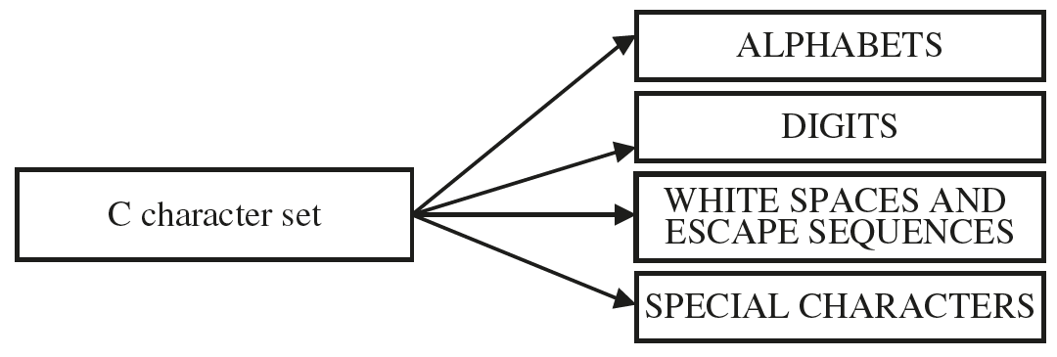
Character Set In C
Characters are used in forming either words or numbers or even expressions in C programming. Characters in C are classified into 4 groups:

Slide 7
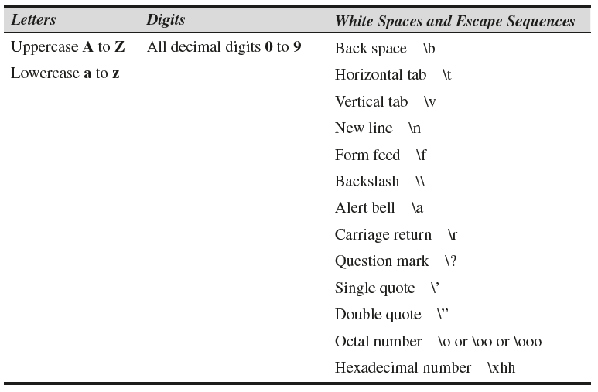
Alphabets, Digits and White Spaces

Slide 8
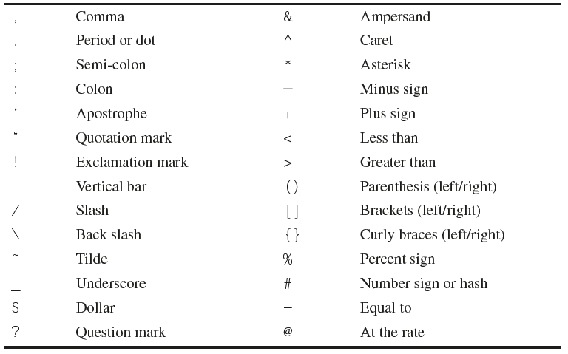
Special characters

Slide 9
Data types in C
Each variable in C has an associated data type.
Each data type requires different amounts of memory and has some specific operations which can be performed over it.
It specifies the type of data that the variable can store like integer, character, floating, double, etc.
The data type is a collection of data with values having fixed values, meaning as well as its characteristics.
Data type | Description
Primitive Data Types | Arithmetic types can be further classified into integer and floating data types.
Void Types | The data type has no value or operator and it does not provide a result to its caller. But void comes under Primitive data types.
User Defined DataTypes | It is mainly used to assign names to integral constants, which make a program easy to read and maintain
Derived types | The data types that are derived from the primitive or built-in datatypes are referred to as Derived Data Types.

Slide 10
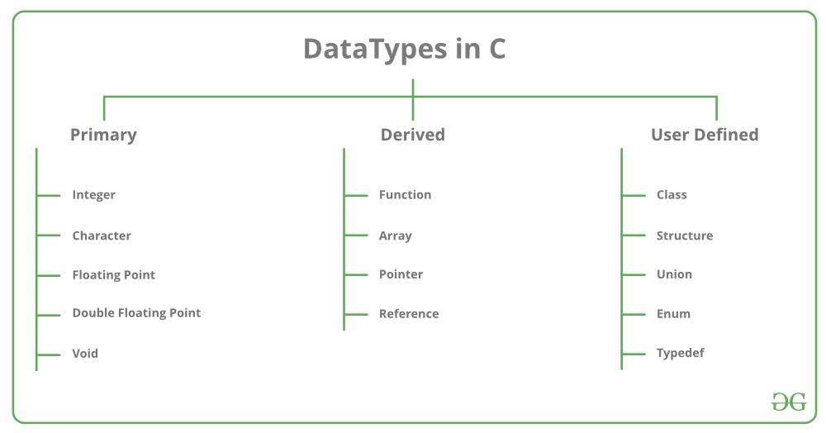
Data types

Slide 11
Primary Data type
Data Type | Memory (bytes) | Range | Format Specifier
short int | 2 | -32,768 to 32,767 | %hd
unsigned short int | 2 | 0 to 65,535 | %hu
unsigned int | 4 | 0 to 4,294,967,295 | %u
int | 4 | -2,147,483,648 to 2,147,483,647 | %d
long int | 4 | -2,147,483,648 to 2,147,483,647 | %ld
unsigned long int | 4 | 0 to 4,294,967,295 | %lu

Slide 12
Primary Data type
Data Type | Memory (bytes) | Range | Format Specifier
long long int | 8 | -(2^63) to (2^63)-1 | %lld
unsigned long long int | 8 | 0 to 18,446,744,073,709,551,615 | %llu
signed char | 1 | -128 to 127 | %c
unsigned char | 1 | 0 to 255 | %c
float | 4 | 1.2E-38 to 3.4E+38 | %f
double | 8 | 1.7E-308 to 1.7E+308 | %lf
long double | 16 | 3.4E-4932 to 1.1E+4932 | %Lf

Slide 13
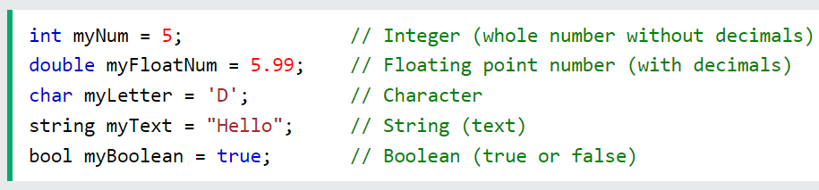
Variables in C
Variables are containers for storing data values.
Variables name starts with either a letter or an underscore. A C variable name can only contain letters, underscore, and numbers.
In C, there are different types of variables (defined with different keywords), for example:
int - stores integers (whole numbers), such as 123 or -123
double - stores floating point numbers, such as 19.99 or -19.99
char - stores single characters, such as 'a' or 'B'. Char values are surrounded by single quotes
string - stores text, such as "Hello World". String values are surrounded by double quotes
bool - stores values with two states: true or false

Slide 14
Constants in C
If you want to define a variable whose value cannot be changed, you can use the const keyword. This will create a constant.
For example,
const double PI = 3.14;
Here, PI is a symbolic constant; its value cannot be changed.
const double PI = 3.14;
PI = 2.9; //Error

Slide 15
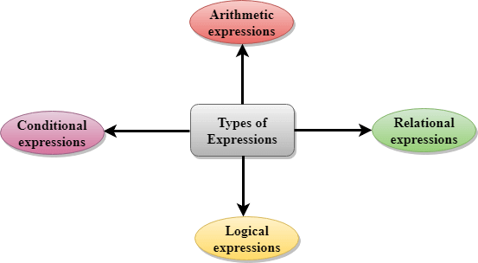
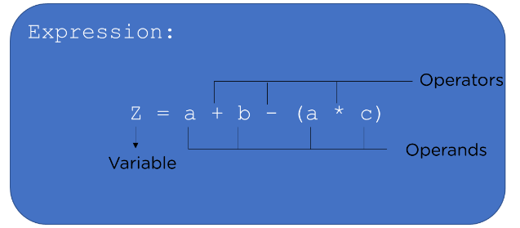
Expressions in C
An expression is a formula in which operands are linked to each other by the use of operators to compute a value. An operand can be a function reference, a variable, an array element or a constant.
There are four types of expressions exist in C:
Arithmetic expressions
Relational expressions
Logical expressions
Conditional expressions

Slide 16
Arithmetic Expressions
An arithmetic expression is an expression that consists of operands and arithmetic operators. An arithmetic expression computes a value of type int, float or double.
When an expression contains only integral operands, then it is known as pure integer expression when it contains only real operands, it is known as pure real expression, and when it contains both integral and real operands, it is known as mixed mode expression.
Evaluation of Arithmetic Expressions
The expressions are evaluated by performing one operation at a time. The precedence and associativity of operators decide the order of the evaluation of individual operations.

Slide 17
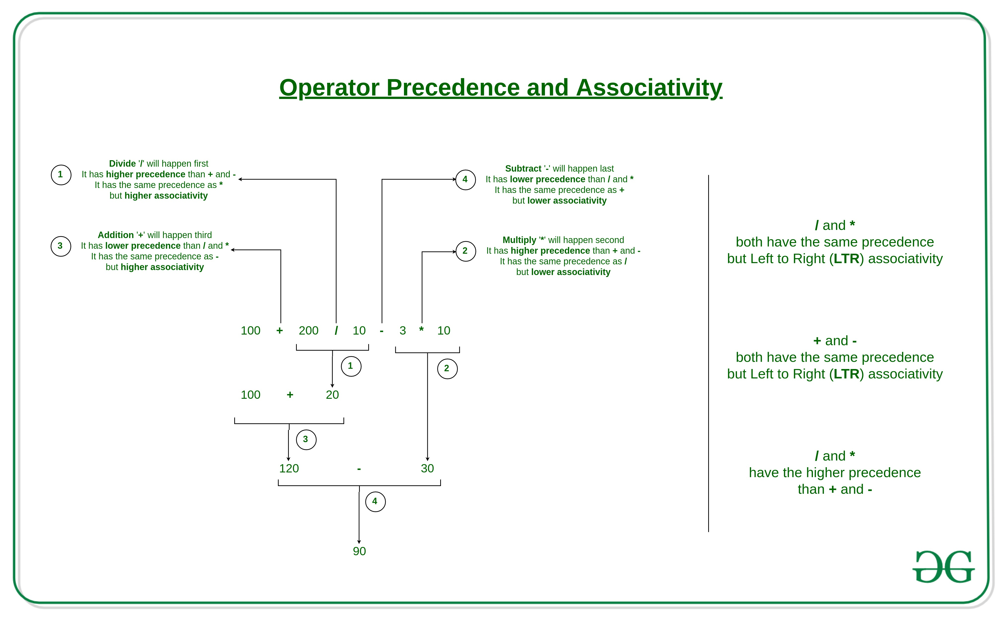
Operators Precedence and Associativity
Operators Precedence and Associativity are two characteristics of operators that determine the evaluation order of sub-expressions in absence of brackets.

Slide 18
Relational Expressions
A relational expression is an expression used to compare two operands.
It is a condition which is used to decide whether the action should be taken or not.
In relational expressions, a numeric value cannot be compared with the string value.
The result of the relational expression can be either zero or non-zero value. Here, the zero value is equivalent to a false and non-zero value is equivalent to true.
Relational Expression | Description
x%2 = = 0 | This condition is used to check whether the x is an even number or not. The relational expression results in value 1 if x is an even number otherwise results in value 0.
a!=b | It is used to check whether a is not equal to b. This relational expression results in 1 if a is not equal to b otherwise 0.
a+b = = x+y | It is used to check whether the expression "a+b" is equal to the expression "x+y".
a>=9 | It is used to check whether the value of a is greater than or equal to 9.

Slide 19
Logical Expressions
A logical expression is an expression that computes either a zero or non-zero value.
It is a complex test condition to take a decision.
Logical Expressions | Description
( x > 4 ) && ( x < 6 ) | It is a test condition to check whether the x is greater than 4 and x is less than 6. The result of the condition is true only when both the conditions are true.
x > 10 || y <11 | It is a test condition used to check whether x is greater than 10 or y is less than 11. The result of the test condition is true if either of the conditions holds true value.
! ( x > 10 ) && ( y = = 2 ) | It is a test condition used to check whether x is not greater than 10 and y is equal to 2. The result of the condition is true if both the conditions are true.

Slide 20
Conditional Expressions
A conditional expression is an expression that returns 1 if the condition is true otherwise 0.
A conditional operator is also known as a ternary operator.

Slide 21
Unary operators in C
Unary operators are operators that act upon a single operand to produce a new value.
Types of unary operators:
unary minus(-)
increment(++)
decrement(- -)
NOT(!)
Address of operator(&)
sizeof()

Slide 22
Operators in C
Operators are symbols that perform operations on variables and values.
Operators in C can be classified into 6 types:
Arithmetic Operators
Assignment Operators
Relational Operators
Logical Operators
Bitwise Operators
Other Operators

Slide 23
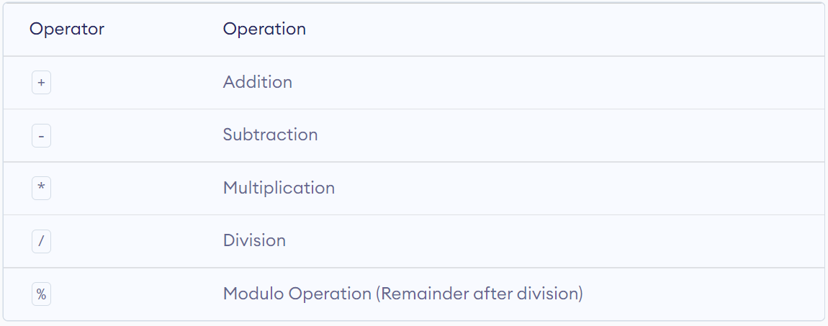
C Arithmetic Operators

Slide 24
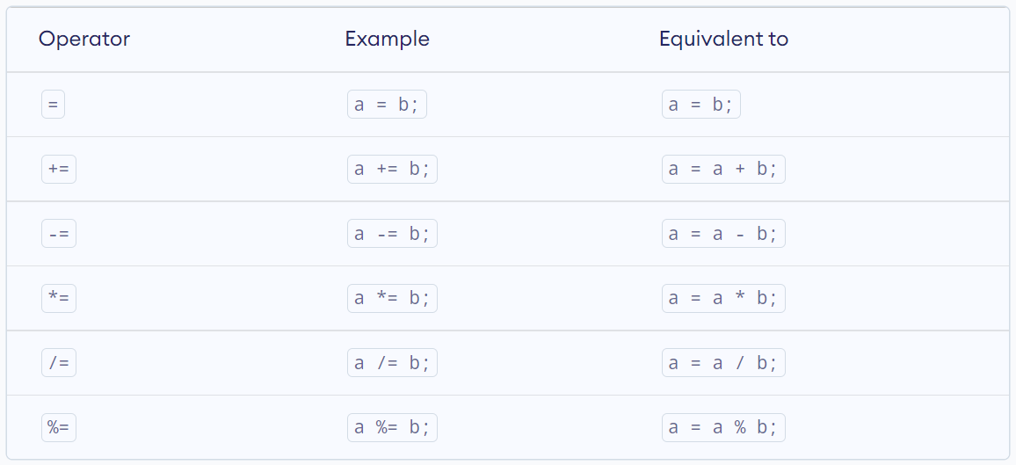
C Assignment Operators

Slide 25
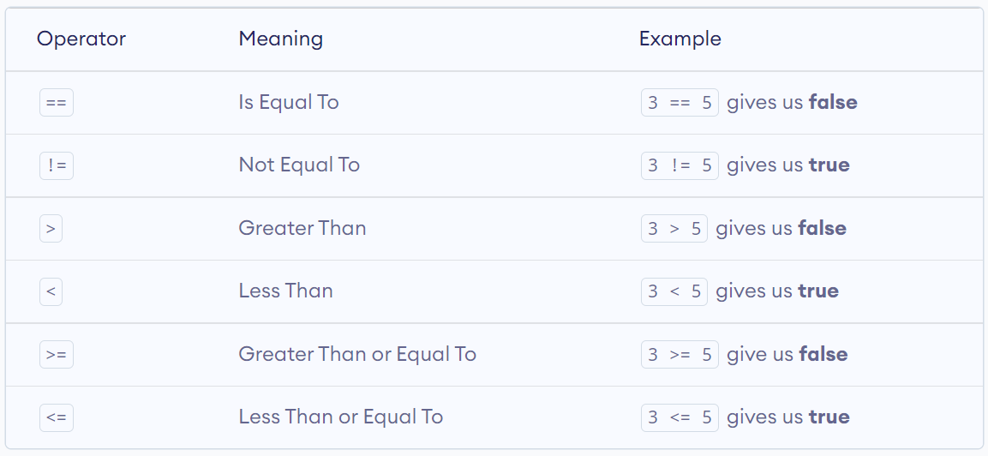
C Relational Operators

Slide 26
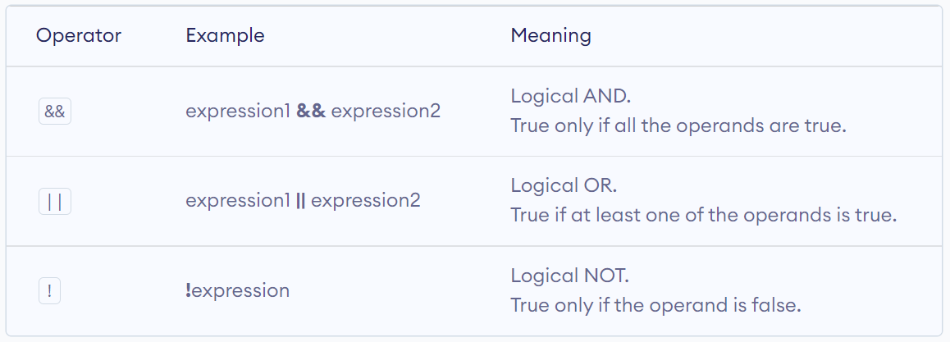
C Logical Operators

Slide 27
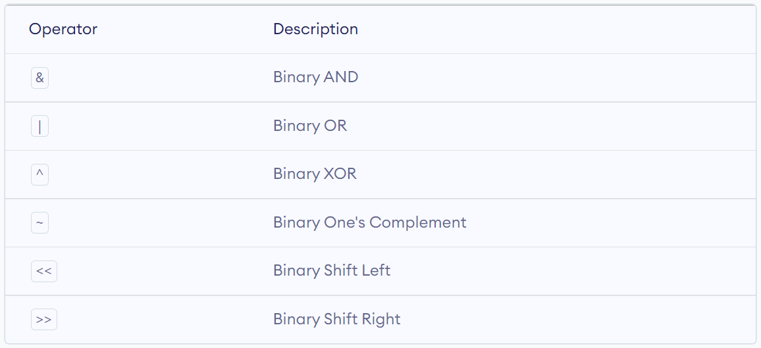
C Bitwise Operators

Slide 28
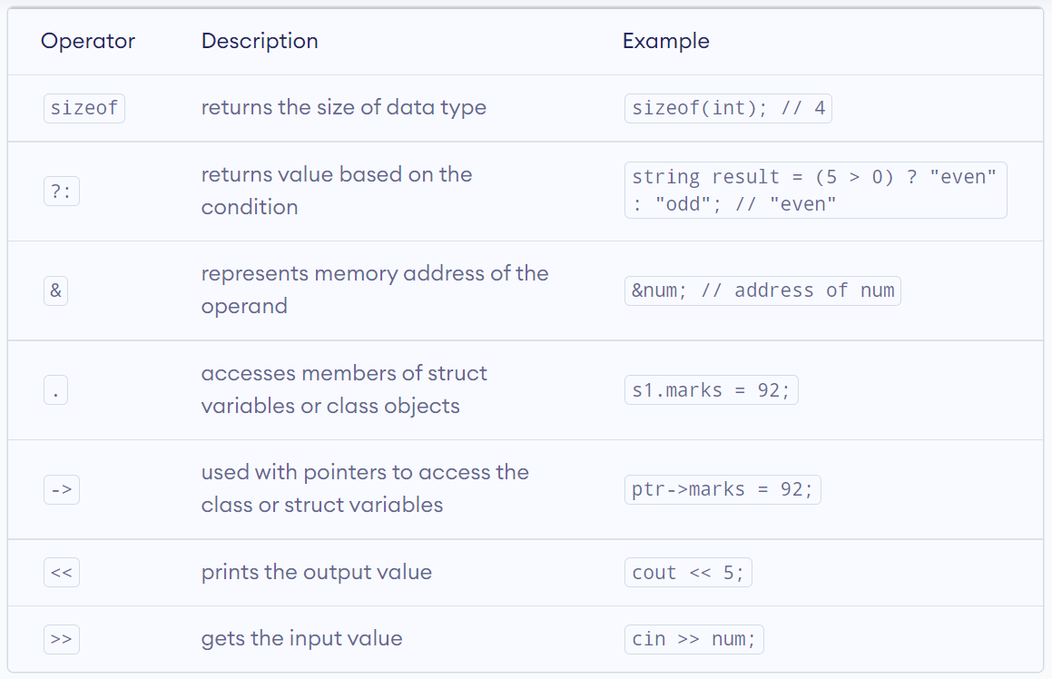
Other C Operators

Slide 29
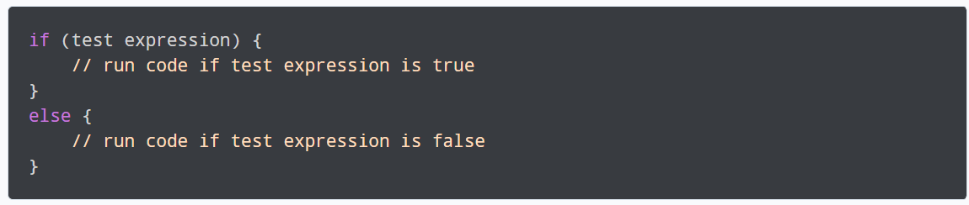
if...else Statement in C
If the test expression is evaluated to be true,
statements inside the body of if are executed.
statements inside the body of else are skipped from execution.
If the test expression is evaluated as false,
statements inside the body of else are executed
statements inside the body of if are skipped from execution.

Slide 30
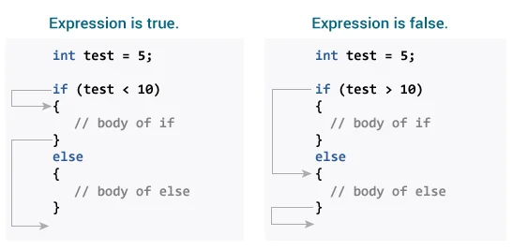
if...else Statement in C

Slide 31
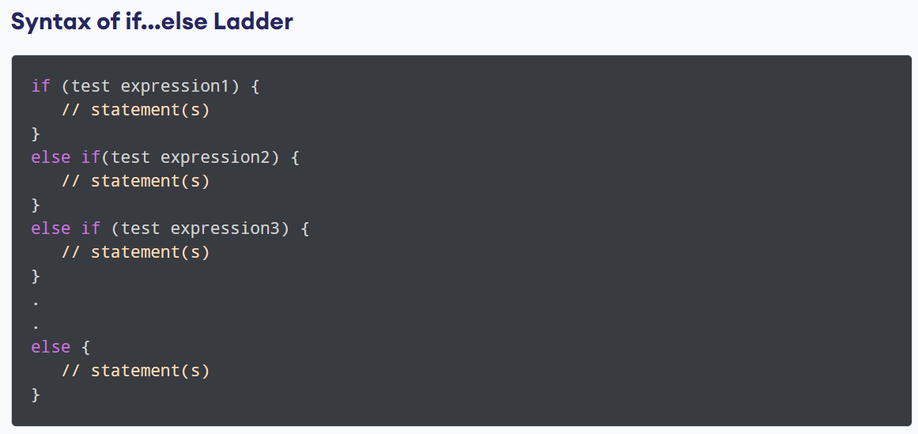
C if...else Ladder
The if...else statement executes two different codes depending upon whether the test expression is true or false. Sometimes, a choice has to be made from more than 2 possibilities.
The if...else ladder allows you to check between multiple test expressions and execute different statements.

Slide 32
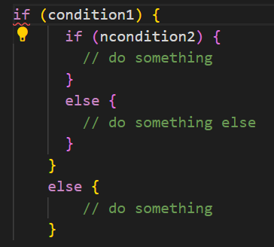
Nested if...else
It is possible to include an if...else statement inside the body of another if...else statement.

Slide 33
Loops in C
In programming, a loop is used to repeat a block of code until the specified condition is met.
C programming has three types of loops:
for loop
while loop
do...while loop

Slide 34
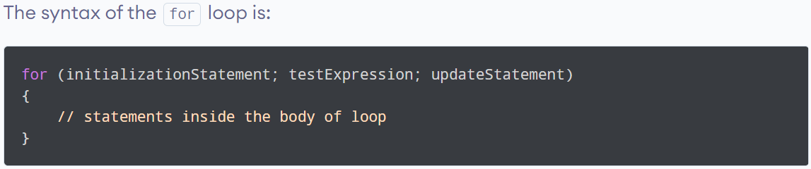
for Loop in C
The initialization statement is executed only once.
Then, the test expression is evaluated. If the test expression is evaluated to false, the for loop is terminated.
However, if the test expression is evaluated to true, statements inside the body of the for loop are executed, and the update expression is updated.
Again the test expression is evaluated.
This process goes on until the test expression is false. When the test expression is false, the loop terminates.

Slide 35
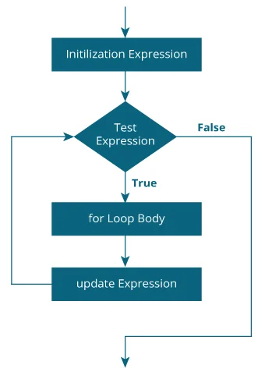
Flow chart for Loop in C
for loop Flowchart

Slide 36
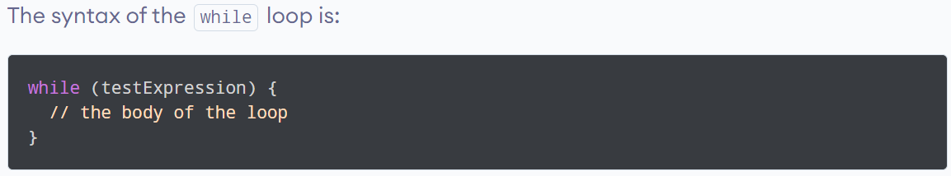
while loop in C
The while loop evaluates the testExpression inside the parentheses ().
If testExpression is true, statements inside the body of while loop are executed. Then, testExpression is evaluated again.
The process goes on until testExpression is evaluated to false.
If testExpression is false, the loop terminates (ends).

Slide 37
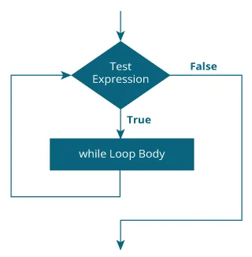
Flowchart of while loop in C
Flowchart of while loop

Slide 38
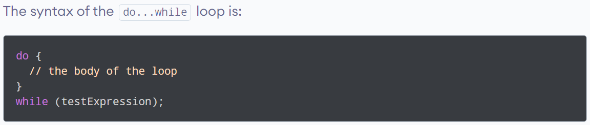
do...while loop in C
The do..while loop is similar to the while loop with one important difference.
The body of do...while loop is executed at least once.
Only then, the test expression is evaluated.

Slide 39
do...while loop in C
How do...while loop works?
The body of do...while loop is executed once. Only then, the testExpression is evaluated.
If testExpression is true, the body of the loop is executed again and testExpression is evaluated once more.
This process goes on until testExpression becomes false.
If testExpression is false, the loop ends.

Slide 40
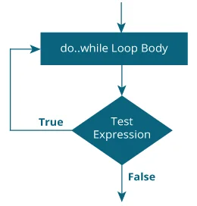
Flowchart of do...while loop in C
Flowchart of do...while Loop

Slide 41
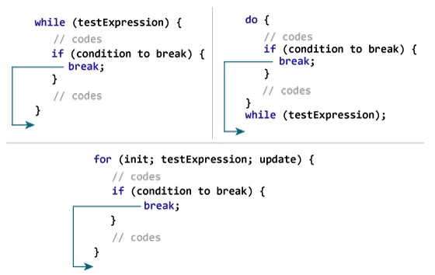
break and continue in C
The break statement ends the loop immediately when it is encountered.
How break statement works?

Slide 42
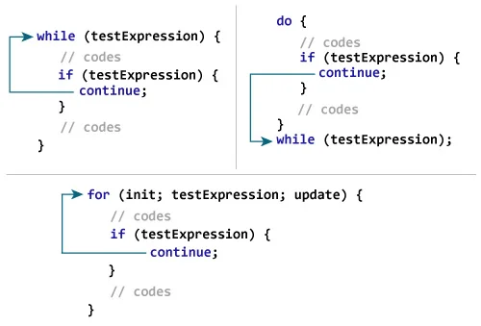
break and continue in C
The continue statement skips the current iteration of the loop and continues with the next iteration.
How continue statement work?

Slide 43
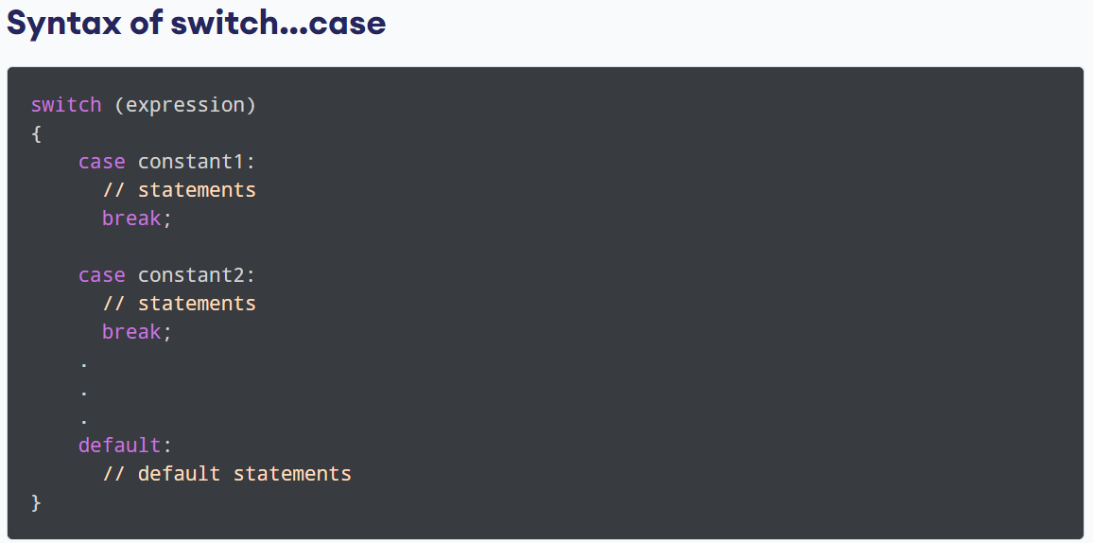
switch statement in C
The switch statement allows us to execute one code block among many alternatives.
You can do the same thing with the if...else..if ladder.
However, the syntax of the switch statement is much easier to read and write.

Slide 44
switch statement in C
How does the switch statement work?
The expression is evaluated once and compared with the values of each case label.
If there is a match, the corresponding statements after the matching label are executed.
If there is no match, the default statements are executed.
If we do not use the break statement, all statements after the matching label are also executed.
The default clause inside the switch statement is optional.

Slide 45
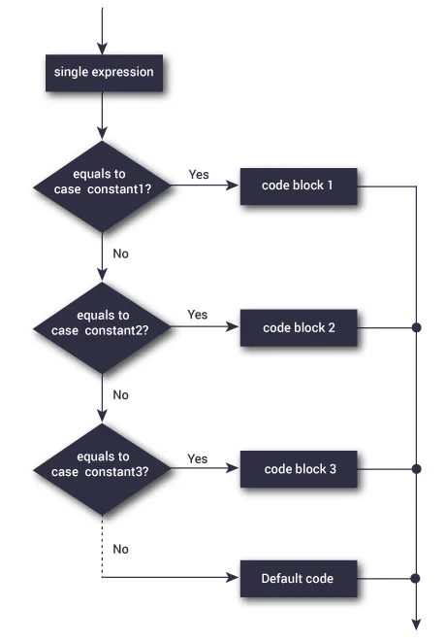
Flowchart of switch statement in C
switch Statement Flowchart

Slide 46
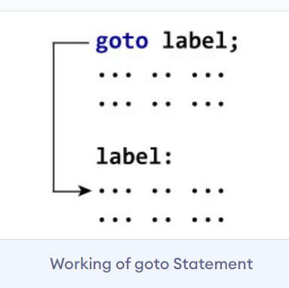
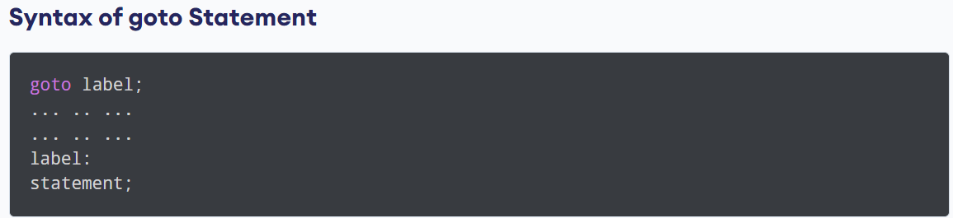
C goto Statement
The goto statement allows us to transfer control of the program to the specified label.
The label is an identifier. When the goto statement is encountered, the control of the program jumps to label: and starts executing the code.

Slide 47
Return Statement
The return statement returns the flow of the execution to the function from where it is called.
This statement does not mandatorily need any conditional statements. As soon as the statement is executed, the flow of the program stops immediately and returns the control from where it was called.
The return statement may or may not return anything for a void function, but for a non-void function, a return value must be returned.
There are various ways to use return statements.
Methods not returning a value:
Methods returning a value:

Slide 48
Methods not returning a value

Slide 49
Type Conversion in C
Type conversion in C is the process of converting one data type to another.
The type conversion is only performed to those data types where conversion is possible.
Type conversion is performed by a compiler.
In type conversion, the destination data type can’t be smaller than the source data type.
Type conversion is done at compile time and it is also called widening conversion because the destination data type can’t be smaller than the source data type.
There are two types of Conversion:
Implicit Type Conversion
Explicit Type Conversion

Slide 50
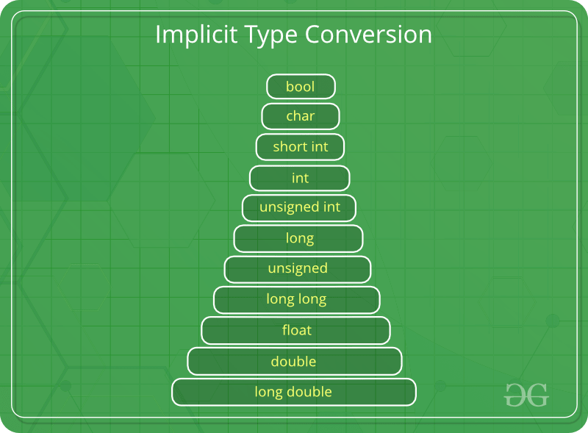
Implicit Type Conversion
Done by the compiler on its own, without any external trigger from the user.
Generally takes place when in an expression more than one data type is present. In such conditions type conversion (type promotion) takes place to avoid loss of data.
All the data types of the variables are upgraded to the data type of the variable with the largest data type.

Slide 51
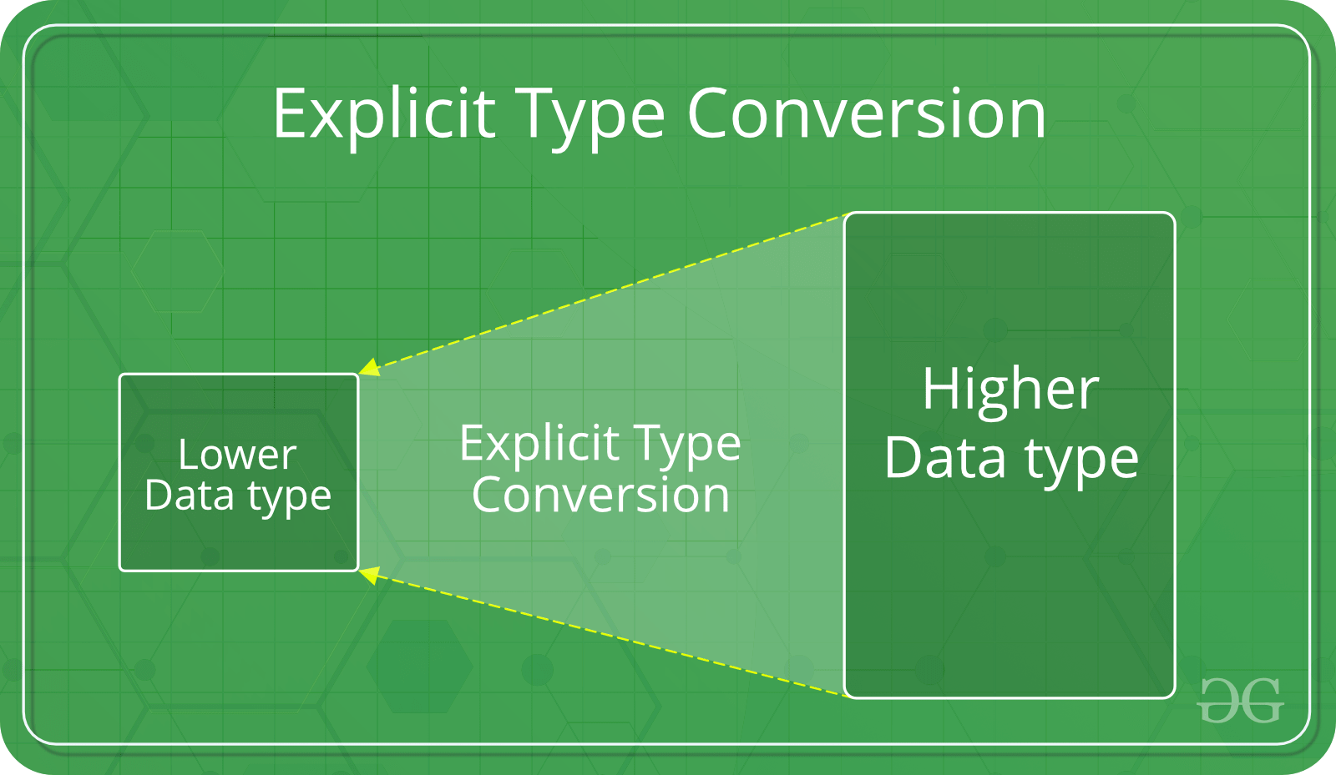
Explicit Type Conversion
This process is also called type casting and it is user-defined. Here the user can typecast the result to make it of a particular data type.
The syntax in C Programming:
(type) expression

Slide 52
Designing Structured Programs in C
Structured programming is a programming technique in which a larger program is divided into smaller subprograms to make it easy to understand, easy to implement and makes the code reusable, etc.
Structured programming enables code reusability. Code reusability is a method of writing code once and using it many times.
Using a structured programming technique, we write the code once and use it many times. Structured programming also makes the program easy to understand, improves the quality of the program, easy to implement and reduces time.
In C, the structured programming can be designed using functions concept. Using functions concept, we can divide the larger program into smaller subprograms and these subprograms are implemented individually. Every subprogram or function in C is executed individually.

Slide 53
Formatted Input/Output functions in C
Formatted I/O functions are used to take various inputs from the user and display multiple outputs to the user.
These types of I/O functions can help to display the output to the user in different formats using the format specifiers.
These I/O supports all data types like int, float, char, and many more.
Why they are called formatted I/O?
These functions are called formatted I/O functions because we can use format specifiers in these functions and hence, we can format these functions according to our needs.

Slide 54
Format Specifiers
S NO. | Format Specifier | Type | Description
1 | %d | int/signed int | used for I/O signed integer value
2 | %c | char | Used for I/O character value
3 | %f | float | Used for I/O decimal floating-point value
4 | %s | string | Used for I/O string/group of characters
5 | %ld | long int | Used for I/O long signed integer value
6 | %u | unsigned int | Used for I/O unsigned integer value
7 | %i | unsigned int | used for the I/O integer value
8 | %lf | double | Used for I/O fractional or floating data
9 | %n | prints | prints nothing

Slide 55
Some of the formatted I/O functions
The following are formatted I/O functions:
printf()
scanf()
sprintf()
sscanf()
printf():
printf() function is used in a C program to display any value like float, integer, character, string, etc on the console screen. It is a pre-defined function that is already declared in the stdio.h(header file).
Syntax:
To display any variable value.
printf(“Format Specifier”, var1, var2, …., varn);

Slide 56
Some of the formatted I/O functions
scanf():
scanf() function is used in the C program for reading or taking any value from the keyboard by the user, these values can be of any data type like integer, float, character, string, and many more. This function is declared in stdio.h(header file), that’s why it is also a pre-defined function. In scanf() function we use &(address-of operator) which is used to store the variable value on the memory location of that variable.
Syntax:
scanf(“Format Specifier”, &var1, &var2, …., &varn);

Slide 57
Some of the formatted I/O functions
sprintf():
sprintf stands for “string print”. This function is similar to printf() function but this function prints the string into a character array instead of printing it on the console screen.
Syntax:
sprintf(array_name, “format specifier”, variable_name);

Slide 58
Some of the formatted I/O functions
sscanf():
sscanf stands for “string scanf”. This function is similar to scanf() function but this function reads data from the string or character array instead of the console screen.
Syntax:
sscanf(array_name, “format specifier”, &variable_name);

Slide 59
Unformatted Input/Output functions
Unformatted I/O functions are used only for character data type or character array/string and cannot be used for any other datatype. These functions are used to read single input from the user at the console and it allows to display the value at the console.
Why they are called unformatted I/O?
These functions are called unformatted I/O functions because we cannot use format specifiers in these functions and hence, cannot format these functions according to our needs.
The following unformatted I/O functions:
getch()
getche()
getchar()
putchar()
gets()
puts()
putch()

Slide 60
Unformatted Input/Output functions
getch():
getch() function reads a single character from the keyboard by the user but doesn’t display that character on the console screen and immediately returned without pressing enter key. This function is declared in conio.h(header file). getch() is also used for hold the screen.
Syntax:
getch();
or
variable-name = getch();

Slide 61
Unformatted Input/Output functions
getche():
getche() function reads a single character from the keyboard by the user and displays it on the console screen and immediately returns without pressing the enter key. This function is declared in conio.h(header file).
Syntax:
getche();
or
variable_name = getche();

Slide 62
Unformatted Input/Output functions
getchar():
The getchar() function is used to read only a first single character from the keyboard whether multiple characters is typed by the user and this function reads one character at one time until and unless the enter key is pressed. This function is declared in stdio.h(header file)
Syntax:
Variable-name = getchar();

Slide 63
Unformatted Input/Output functions
putchar():
The putchar() function is used to display a single character at a time by passing that character directly to it or by passing a variable that has already stored a character. This function is declared in stdio.h(header file)
Syntax:
putchar(variable_name);

Slide 64
Unformatted Input/Output functions
gets():
gets() function reads a group of characters or strings from the keyboard by the user and these characters get stored in a character array. This function allows us to write space-separated texts or strings. This function is declared in stdio.h(header file).
Syntax:
char str[length of string in number]; //Declare a char type variable of any length
gets(str);

Slide 65
Unformatted Input/Output functions
puts():
In C programming puts() function is used to display a group of characters or strings which is already stored in a character array. This function is declared in stdio.h(header file).
Syntax:
puts(identifier_name );

Slide 66
Unformatted Input/Output functions
putch():
putch() function is used to display a single character which is given by the user and that character prints at the current cursor location. This function is declared in conio.h(header file)
Syntax:
putch(variable_name);

